Slide 1

Data Mining & Processing Project
Business and Big Data Analytics Diploma - 2025
Prepared by:
Ahmed Abodonia
Ahmed Elshebiny
Supervised by:
Dr. Amal Mohamed

Slide 2
Agenda
Introduction
Data Overview
Problem Definition
Challenges and Preprocessing
Algorithm Selection
Testing results
Evaluation and Model Comparisons
Conclusion

Slide 3
Agenda
Introduction
Data Overview
Problem Definition
Challenges and Preprocessing
Algorithm Selection
Testing results
Evaluation and Model Comparisons
Conclusion

Slide 4
Introduction
Objective:
This presentation explores a healthcare dataset to predict Test Results (Normal, Abnormal, Inconclusive) using machine learning.
Dataset Overview:
The dataset, sourced from Kaggle, contains features like Age, Gender, Medical Condition, Billing Amount, and more, generated using Python's Faker library.
Approach:
We preprocessed the data, addressed challenges like duplicates and incorrect datatypes, and compared three classification models: Decision Tree, Random Forest, and Naive Bayes.
Goal:
To identify the best-performing model and provide insights for improving healthcare data analysis.

Slide 5
Agenda
Introduction
Data Overview
Problem Definition
Challenges and Preprocessing
Algorithm Selection
Testing results
Evaluation and Model Comparisons
Conclusion

Slide 6
Dataset Overview
Source:
Healthcare dataset from Kaggle, generated using Python's Faker library.
Size:
55,500 records with 15 features.
Key Features:
Patient Details: Name, Age, Gender, Blood Type.
Medical Information: Medical Condition, Date of Admission, Discharge Date, Doctor, Hospital.
Billing & Logistics: Billing Amount, Room Number, Insurance Provider.
Treatment Details: Admission Type, Medication, Test Results.
Target Variable:
Test Results with three categories: Normal, Abnormal, and Inconclusive.
Data Types:
Numeric: Age, Billing Amount, Room Number.
Categorical: Gender, Blood Type, Medical Condition, etc.
Datetime: Date of Admission, Discharge Date.

Slide 7
Agenda
Introduction
Data Overview
Problem Definition
Challenges and Preprocessing
Algorithm Selection
Testing results
Evaluation and Model Comparisons
Conclusion

Slide 8
Problem Definition
We selected a Healthcare Dataset from Kaggle, generated using Python's Faker library.
Dataset link on Kaggle
Dataset Features: Includes attributes like Name, Age, Gender, Blood Type, Medical Condition, Date of Admission, Doctor, Hospital, Insurance Provider, Billing Amount, Room Number, Admission Type, Discharge Date, Medication, and Test Results.
Goal:
To treat the dataset as a classification problem and predict the Test Results, which fall into three categories: Normal, Abnormal, and Inconclusive.

Slide 9
Agenda
Introduction
Data Overview
Problem Definition
Challenges and Preprocessing
Algorithm Selection
Testing results
Evaluation and Model Comparisons
Conclusion

Slide 10
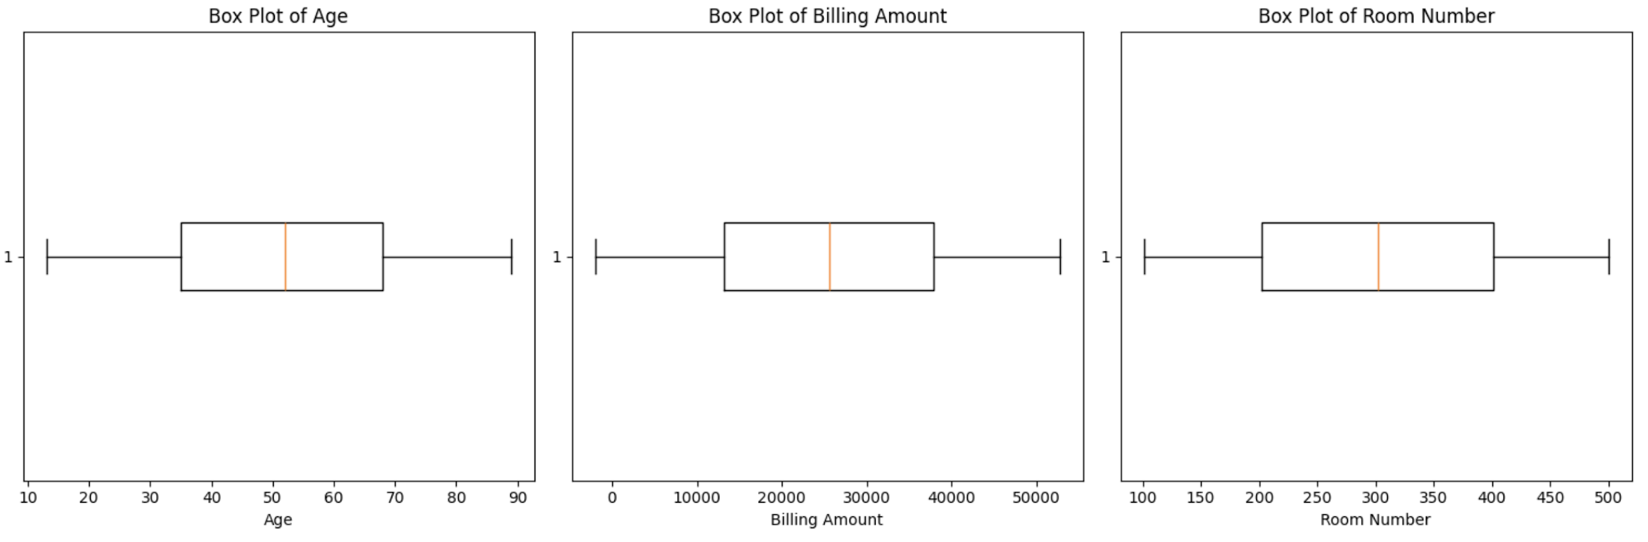
Challenges and Preprocessing
The Dataset had some problems:
There were duplicated rows
Solution: We dropped the Duplicated Rows
There were wrong datatypes in (Date of Admission and Discharge Date)
Solution: we changed data type from object to datetime
There were no outliers but there were negative values for the (Billing Amount) which is not logic
Solution: we replaced the negative values with the median

Slide 11
Agenda
Introduction
Data Overview
Problem Definition
Challenges and Preprocessing
Algorithm Selection
Testing results
Evaluation and Model Comparisons
Conclusion

Slide 12
Algorithm Selection
We compared three classification models:
Decision Tree
Random Forest
Naive Bayes
The goal was to evaluate their performance and identify the best model for our data.

Slide 13
Agenda
Introduction
Data Overview
Problem Definition
Challenges and Preprocessing
Algorithm Selection
Testing results
Evaluation and Model Comparisons
Conclusion

Slide 14
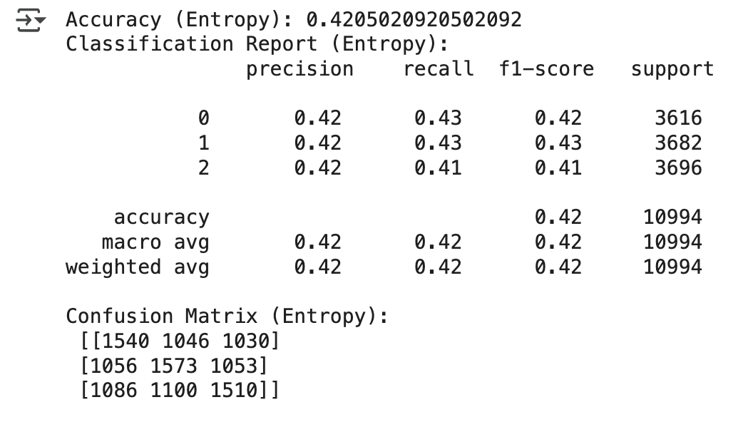
Testing results (Decision Tree)
The model achieved an accuracy of 42%, The confusion matrix shows relatively low performance for this model suggesting the need for further tuning or a different approach to improve performance.

Slide 15
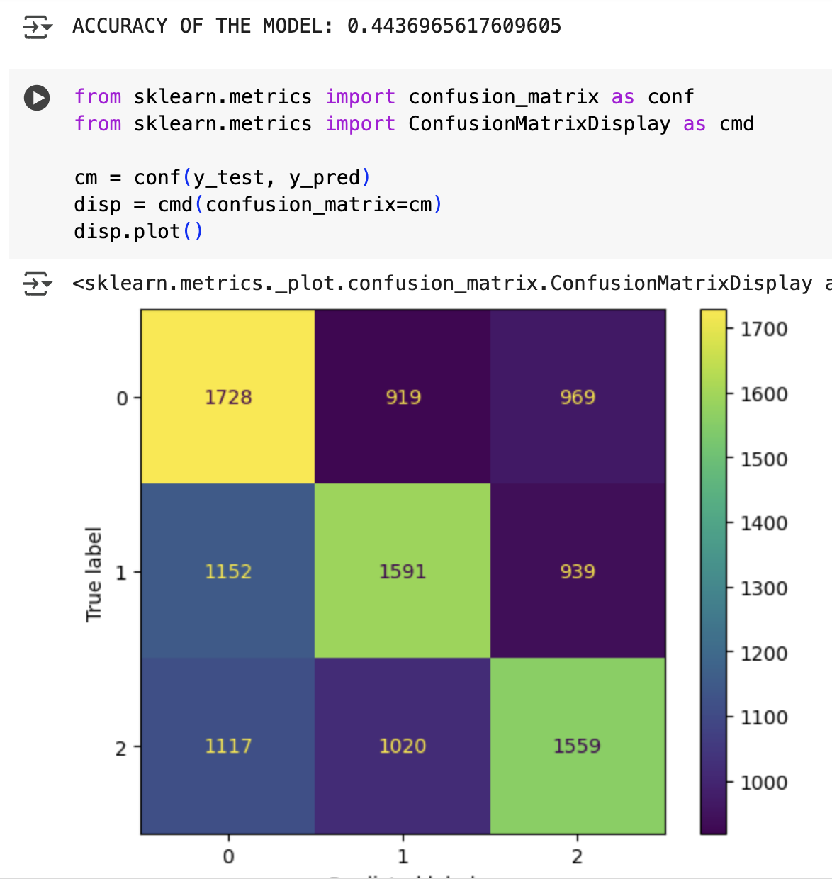
Testing results (Random Forest)
The Random Forest model (44.37% accuracy) performed slightly better than the Entropy-based model (42.05% accuracy). However, both models show low performance and requires further enhancements.

Slide 16
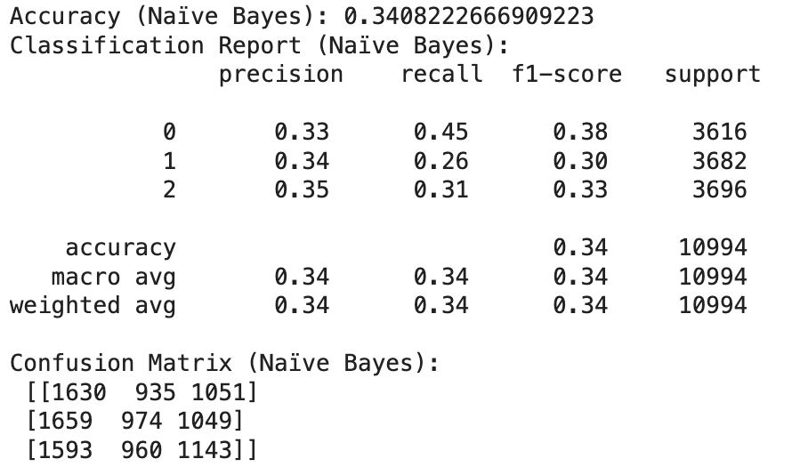
Testing results (Naïve Bayes)
The Naïve Bayes model achieved an accuracy of 34.08%, lower than both the Entropy-based (42.05%) and Random Forest (44.37%) models. Its precision, recall, and F1-scores are also weaker, with higher misclassifications in the confusion matrix for test results prediction.

Slide 17
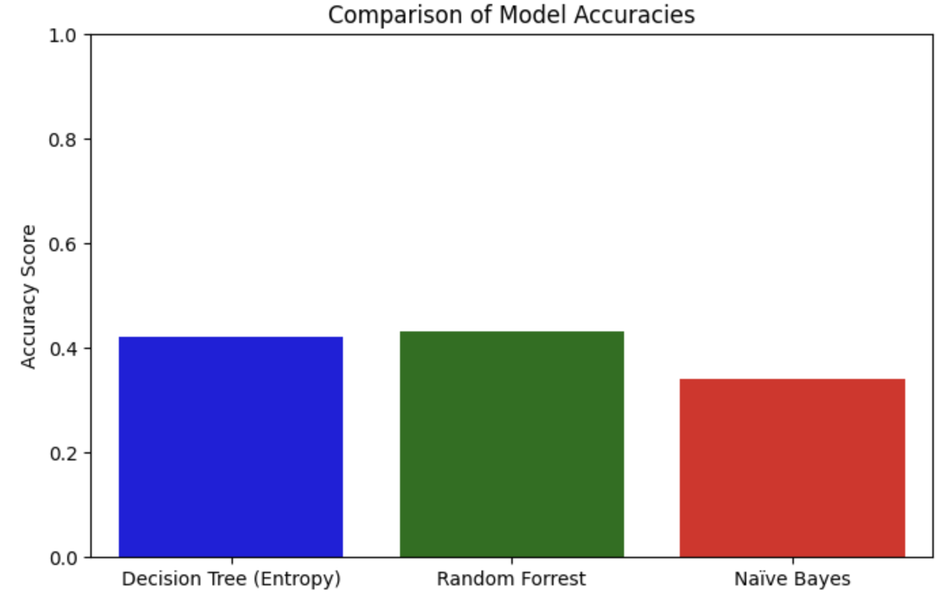
Comparison between the three models
Decision Tree (Entropy): 42.05% accuracy
Random Forest: 44.37% accuracy
Naïve Bayes: 34.08% accuracy
The Random Forest model performed the best, followed by the Decision Tree, while Naïve Bayes had the lowest accuracy. All models show room for improvement, with significant misclassifications across the testing results feature.

Slide 18
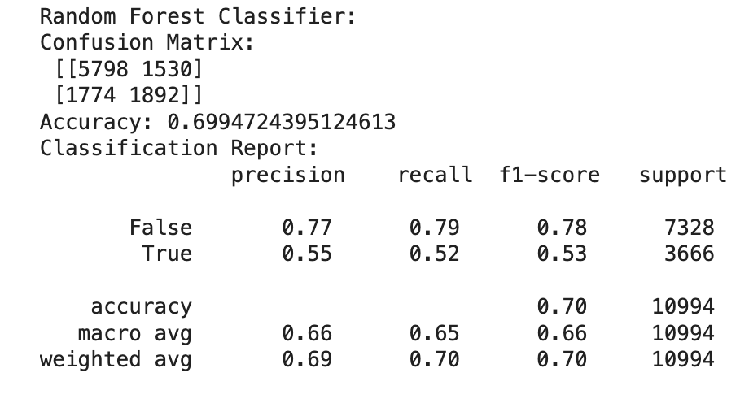
Enhancing The Model using Random Forest Classifier
Random Forest Classifier:
Achieved an accuracy of 69.95%, with better precision and recall for the "False" class (0.77 and 0.79) compared to the "True" class (0.55 and 0.52). The model shows improved performance over previous attempts but still struggles with the "True" class.

Slide 19
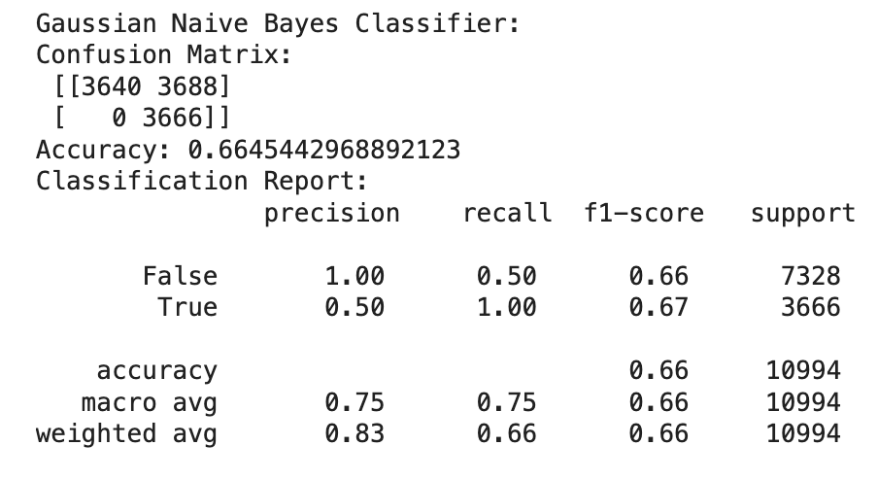
Enhancing The Model using Naive Bayes Classifier
Gaussian Naive Bayes Classifier:
Achieved an accuracy of 66.45%, with perfect recall for the "True" class (1.00) but very low precision (0.50). This indicates the model tends to overpredict the "True" class, leading to many false positives.

Slide 20
Agenda
Introduction
Data Overview
Problem Definition
Challenges and Preprocessing
Algorithm Selection
Testing results
Evaluation and Model Comparisons
Conclusion

Slide 21
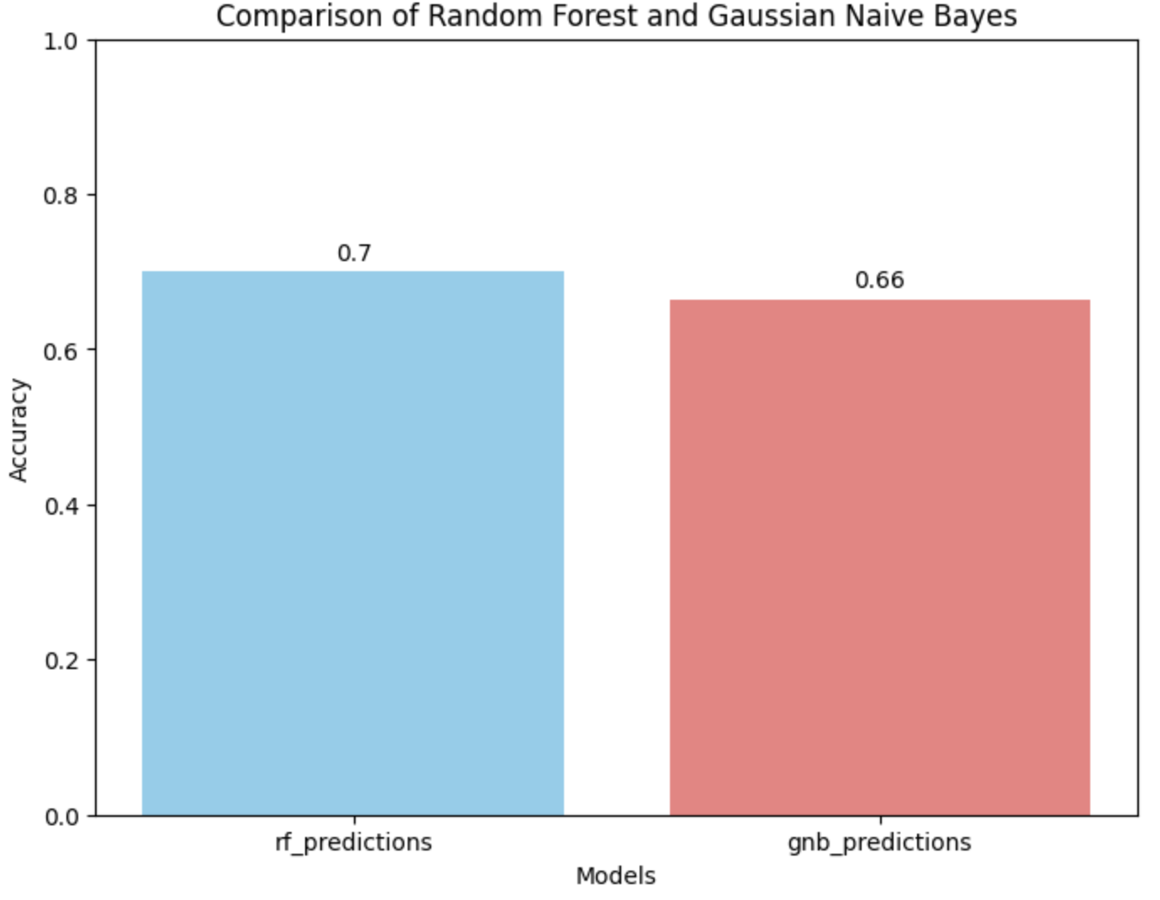
Comparing the new results
Random Forest: Better accuracy (69.95%) and more balanced performance across classes.
Naive Bayes: Lower accuracy (66.45%) with high false positives despite good recall for the "True" class.
Key Observations:
The Random Forest model performs better overall, with a more balanced approach to both classes.
Naive Bayes, while achieving high recall for the "True" class, suffers from low precision, making it less reliable for this task.
Both models improved by focusing on a single class, with Random Forest performing better overall..

Slide 22
Agenda
Introduction
Data Overview
Problem Definition
Challenges and Preprocessing
Algorithm Selection
Testing results
Evaluation and Model Comparisons
Conclusion

Slide 23
Conclusion
Problem Definition:
We picked a healthcare dataset to predict Test Results (Normal, Abnormal, Inconclusive) as a classification problem.
Challenges & Preprocessing:
Addressed issues like duplicated rows, incorrect datatypes, and negative billing amounts.
Used box plots to analyze distributions of Age, Billing Amount, and Room Number.
Algorithm Selection:
Compared three models: Decision Tree, Random Forest, and Naive Bayes.
Model Performance:
Random Forest performed the best with 44.37% accuracy, followed by Decision Tree (42.05%) and Naive Bayes (34.08%).
All models struggled with misclassifications, indicating room for improvement.
Enhancements:
Improved performance by focusing on a single class (Normal) and using better encoding methods.
Random Forest achieved 69.95% accuracy, outperforming Naive Bayes (66.45%).
Final outcome:
Random Forest is the most reliable model for this dataset.
Preprocessing and feature engineering significantly impact model performance.
Future work could explore better algorithms, tuning model settings, or improving data quality for even better results.

